Slide 1
Part Three: Cloud Security Practices
Chapter 3.1
Key Management

Slide 2
Diffie-Hellman Key Exchange
Discovered by Whitfield Diffie and Martin Hellman
“New Directions in Cryptography”
Diffie-Hellman key agreement protocol
Exponential key agreement
Allows two users to exchange a secret key
Requires no prior secrets
Real-time over an untrusted network

Slide 3
Introduction
Based on the difficulty of computing discrete logarithms of large numbers.
Requires two large numbers, one prime (P), and (G), a primitive root of P

Slide 4
Implementation
P and G are both publicly available numbers
P is at least 512 bits
Users pick private values a and b
Compute public values
x = gª mod p
y = g^{b} mod p
Public values x and y are exchanged

Slide 5
Implementation
Compute shared, private key
k_{a} = yª mod p
k_{b} = x^{b} mod p
Algebraically it can be shown that k_{a} = k_{b}=g^{ab}
Users now have a symmetric secret key to encrypt

Slide 6
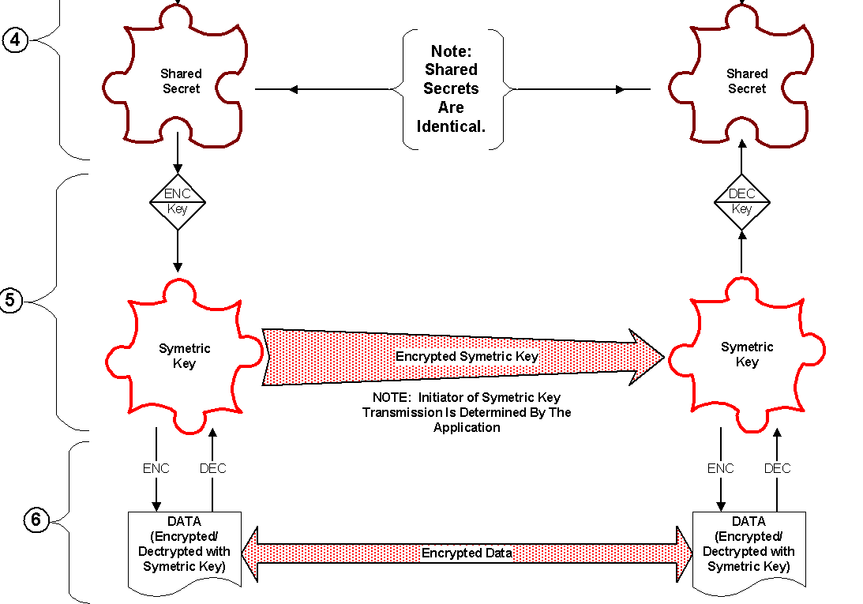
Implementation

Slide 7
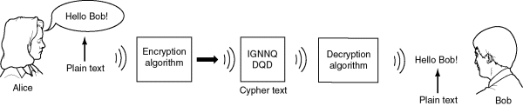
Example
Two Internet users, Alice and Bob wish to have a secure conversation.
They decide to use the Diffie-Hellman protocol

Slide 8
Example
Alice and Bob get public numbers
P = 23, G = 9
Alice and Bob compute public values
X = 9⁴ mod 23 = 6561 mod 23 = 6
Y = 9³ mod 23 = 729 mod 23 = 16
Alice and Bob exchange public numbers
Alice and Bob compute k_{a}=k_{b}=16⁴=6³=9

Slide 9
Applications
Diffie-Hellman is currently used in many protocols, namely:
Secure Sockets Layer (SSL)/Transport Layer Security (TLS)
Secure Shell (SSH)
Internet Protocol Security (IPSec)
Public Key Infrastructure (PKI)

Slide 10
Man-in-the-middle Attack
A, gª
E
A, g^{a’}
A
B
B, g^{b’}
B, g^{b}
g^{ab’}
g^{a’b}

